Slide 1
Computer language
Notes:
Title

Slide 2
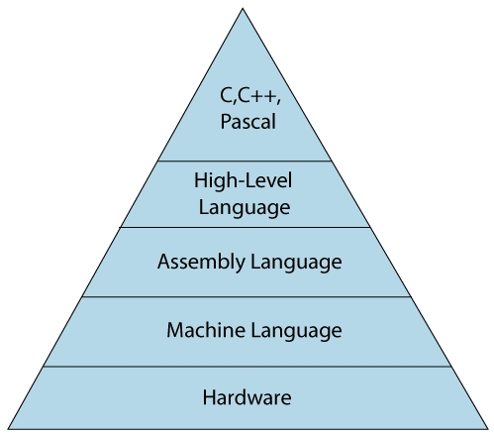
Development of computer language
To communicate with a computer, we need a language which a computer understands.
For every action, a computer has to be given instructions accordingly.
Program is a set of instructions which tells the computer what to do.
Process of writing the specific instructions in a computer language is called programming.
Each programming language has its own specific rules and syntax.
Lady Ada Lovelace is regarded as the first computer programmer.
The development of programming language has improved considerably with the ease and ability of programmers to write powerful application programs that can solve any task in the world today.
The development of computer languages has been classified into the following categories:
First generation as Machine language
Second generation as Assembly language
Third generation as High- level Language
Fourth generation Language.
Notes:
Electronic machine that works on electricity
It can do variety of jobs
They can be seen everywhere around is like
Shops
Schools
Hospitals
Banks
Airports
Railway stations etc.
they give 100 percent accurate results.
Definition
It is an electronic device that accepts data and instructions given by user, processes them accordingly and gives meaningful results.

Slide 3
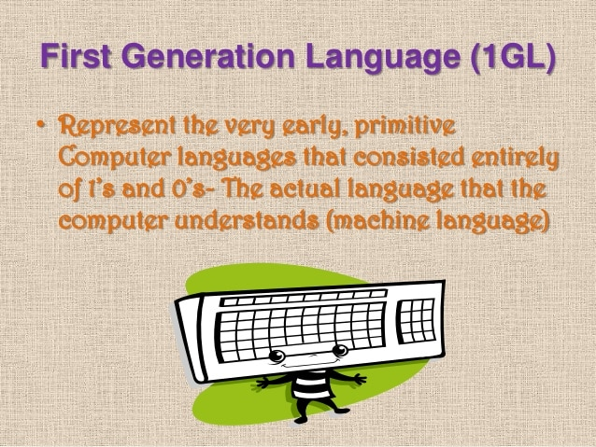
Machine Language ( First Generation)
It is the only language that computer understands.
It is expressed in binary form that is ..’0’ and ‘1’.
0 means ‘off’ state and ‘1’ means ‘on’ state.
It is high speed and very low memory utilization.
Tough to learn and understand, time consuming.
Difficult to write and debug programs written in machine language.
Machine dependent.
This is called low level language(LLL).
Notes:
Early human and sign language contributed to the development of verbal and written message.
Now reached the age of satellite and computer technology which brought revolution in the field of communication.

Slide 4
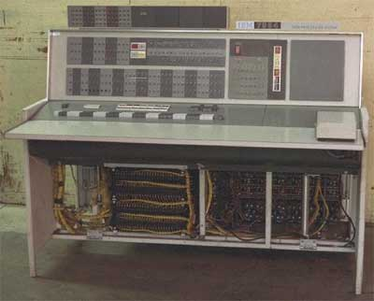
Assembly Language (Second generation Language)
Mnemonic codes or symbols are used instead of binary numbers.
Easier to understand and work with it uses symbolic memory addresses are used rather than machine language.
Eg: if the operation code for addition is 0010, it’s equivalent in assembly language is ‘Add’.
As computer understands only machine language, translators are developed to convert assembly language into machine language and called as Assemblers.
Program written in assembly language called as source program.
Program converted into machine language called as object code.
It is also machine dependent and programming is time consuming.
It is also called as low level language.(LLL).
Notes:
Hardware and software are interdependent.
Without software, a computer cannot work. Similarly, if hardware is not there, software is of no use.
Illustration example:-
To listen to music, we require a music system. The music system, CBS and DVD are hardware because we can touch them. Can you touch the songs..? No, because that is software. We need both to enjoy the music.

Slide 5
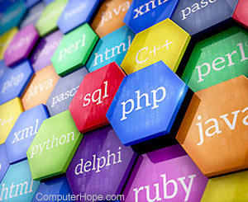
High level language ( Third Generation language)
Restrictions of machine and assembly language prompted people to develop a language with following features.
Simple and user friendly language.
Language is machine independent
easy to learn and write the program using this language.
It is called high level language. (HLL).
It is similar to english language.
The term software was first used by John W turkey.
Basic C, C++, Java etc are some of the popular high level language.
Translators are used to convert high level language into machine language.
Notes:
Let us learn about what exactly is the effective communication and how do we achieve this.
Definition
Communication between two or more people where the intended message is successfully delivered, received and understood.

Slide 6
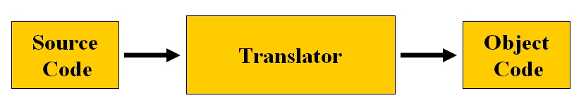
Translator programs types
High level language programs needs to be translated into machine language in order to become machine understanding this is done using translator programs.
Two types of translator programs :-
Interpreter
Compiler
Notes:
Features
Involves sender, receiver while communication both should share mutually accepted code I.e common language.
Message should be clear, should convey right meanings to others.
Listening to others is a very important aspect of effective communication.
Communication is a process in which input and output should be there. Meaningful communication results in response from receiver.

Slide 7
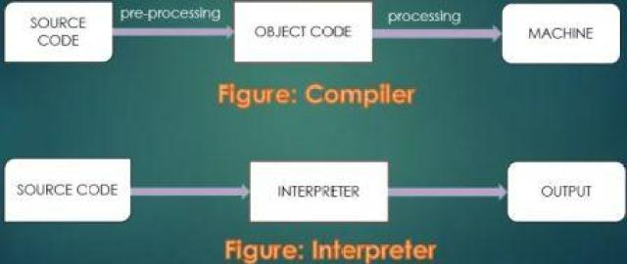
Workflow of compiler Vs interpreter
Notes:
Effective communication is essential in every sphere of life.
be it Personal, it might be professional or social
It includes all aspects of Visual , auditory and body language
so that it appeals to listener.

Slide 8
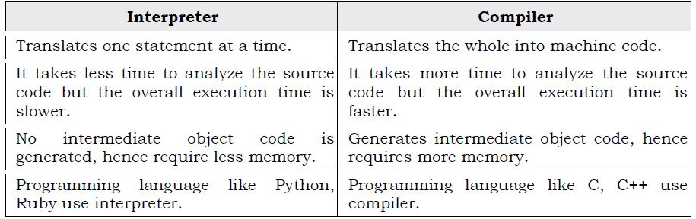
Comparision between compiler and interpreter

Slide 9
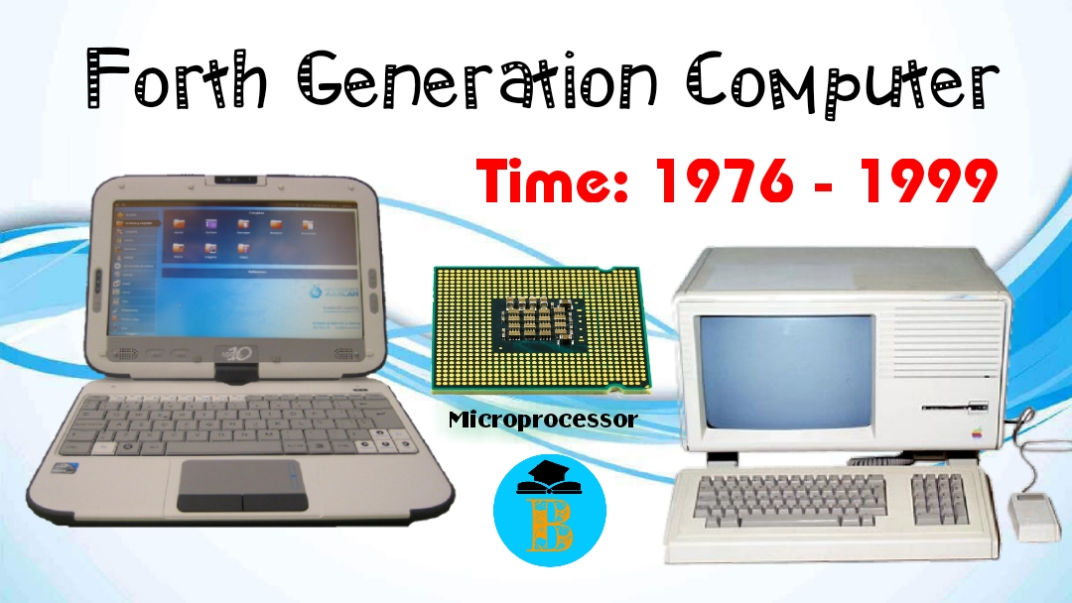
Fourth generation language (4GL)
Closer to human language compared to other high level language.
Locator identifier separation Protocol (LISP) was the first computer language for writing artificial intelligence programs.
The first interactive computer game was Spacewar.
The features of 4GL includes:-
Highly user friendly , portable and independent of OS.
Very high speed of execution.
Reduced level of programming efforts.
Minimum efforts from user to obtain any information.
Reduced Time and cost to develop a software.
In 4GL, the user has to specify only required output and format of output without bothering about the steps required to obtain that.
Eg: Application development tool
Notes:
Story illustration
father planned an urgent trip to his son’shone in another state.
He sent an email to his son.
In the mail, he wrote ‘Reach tomorrow’s instead of ‘reaching tomorrow ‘ by mistake when the father reached his son’s home, his d-inlaw was surprised to see him bcoz son already left to visit his father.
The dinlaw showed him email which stated ‘reach tomorrow ‘ instead of ‘reaching tomorrow ‘
The ‘ing’ created miscommunication and big confusion.
It can cause serious problem. It can have far reachingconsequences resulting in loss of time, money, trust and may also impact relationships.

Slide 10


Slide 11


